Slide 1
Daily Health Monitor User Guide

Slide 2
Table of Content
Overview (3)
01
Getting Started (4)
02
Using Daily Health Monitor (5)
03
Get Support (19)
04

Slide 3
Overview
The Daily Health Monitor is a Windows Forms application. Due to the prevalence of COVID-19, company needs to manage employee health records and monitor employee health status. The Daily Health Monitor is designed to meet user's requirements of viewing, editing and searching employee health records.
Special Requirements:
One employee health record must include following information: Gin Number, first name, last name, date, visited Hubei recently or not, has abnormal symptom or not, body temperature.
Gin Number, which is a positive integer, represents employee's identity. One Gin Number can be only associated with one name.
One employee has up to one health record at each day.
Body temperature should not exceed the reasonable range (between 35 and 42 degrees).
The employee is considered a suspected case if he/she visited Hubei recently, or has abnormal symptom, or his/her body temperature is more than 37.3 degrees.

Slide 4
Getting Started
OS: Windows 10, 64-bit Operating System
Download the ZIP file from https://github.com/SZ559/HealthInformationWindowsApp
Unzip the file
Open WindowsFormsApp.sln using Visual Studio 2019
Run the program

Slide 5
Using Daily Health Monitor: Overview
Open CSV file (6)
Add new health record (7)
Edit existed health record (8)
Delete existed health record (9)
Delete all health records displayed in data grid view (10)
View health records by year, month, or date (11)
View health records by last name or Gin Number and name (12)
Search health records by Gin Number (13)
Search health records by date, visited Hubei or not, has abnormal symptom or not or suspected case (14)
Sort health records by Gin Number, first name, last name or date (15)
View status bar (16)
View toolbar (17)
Save as CSV file (18)

Slide 6
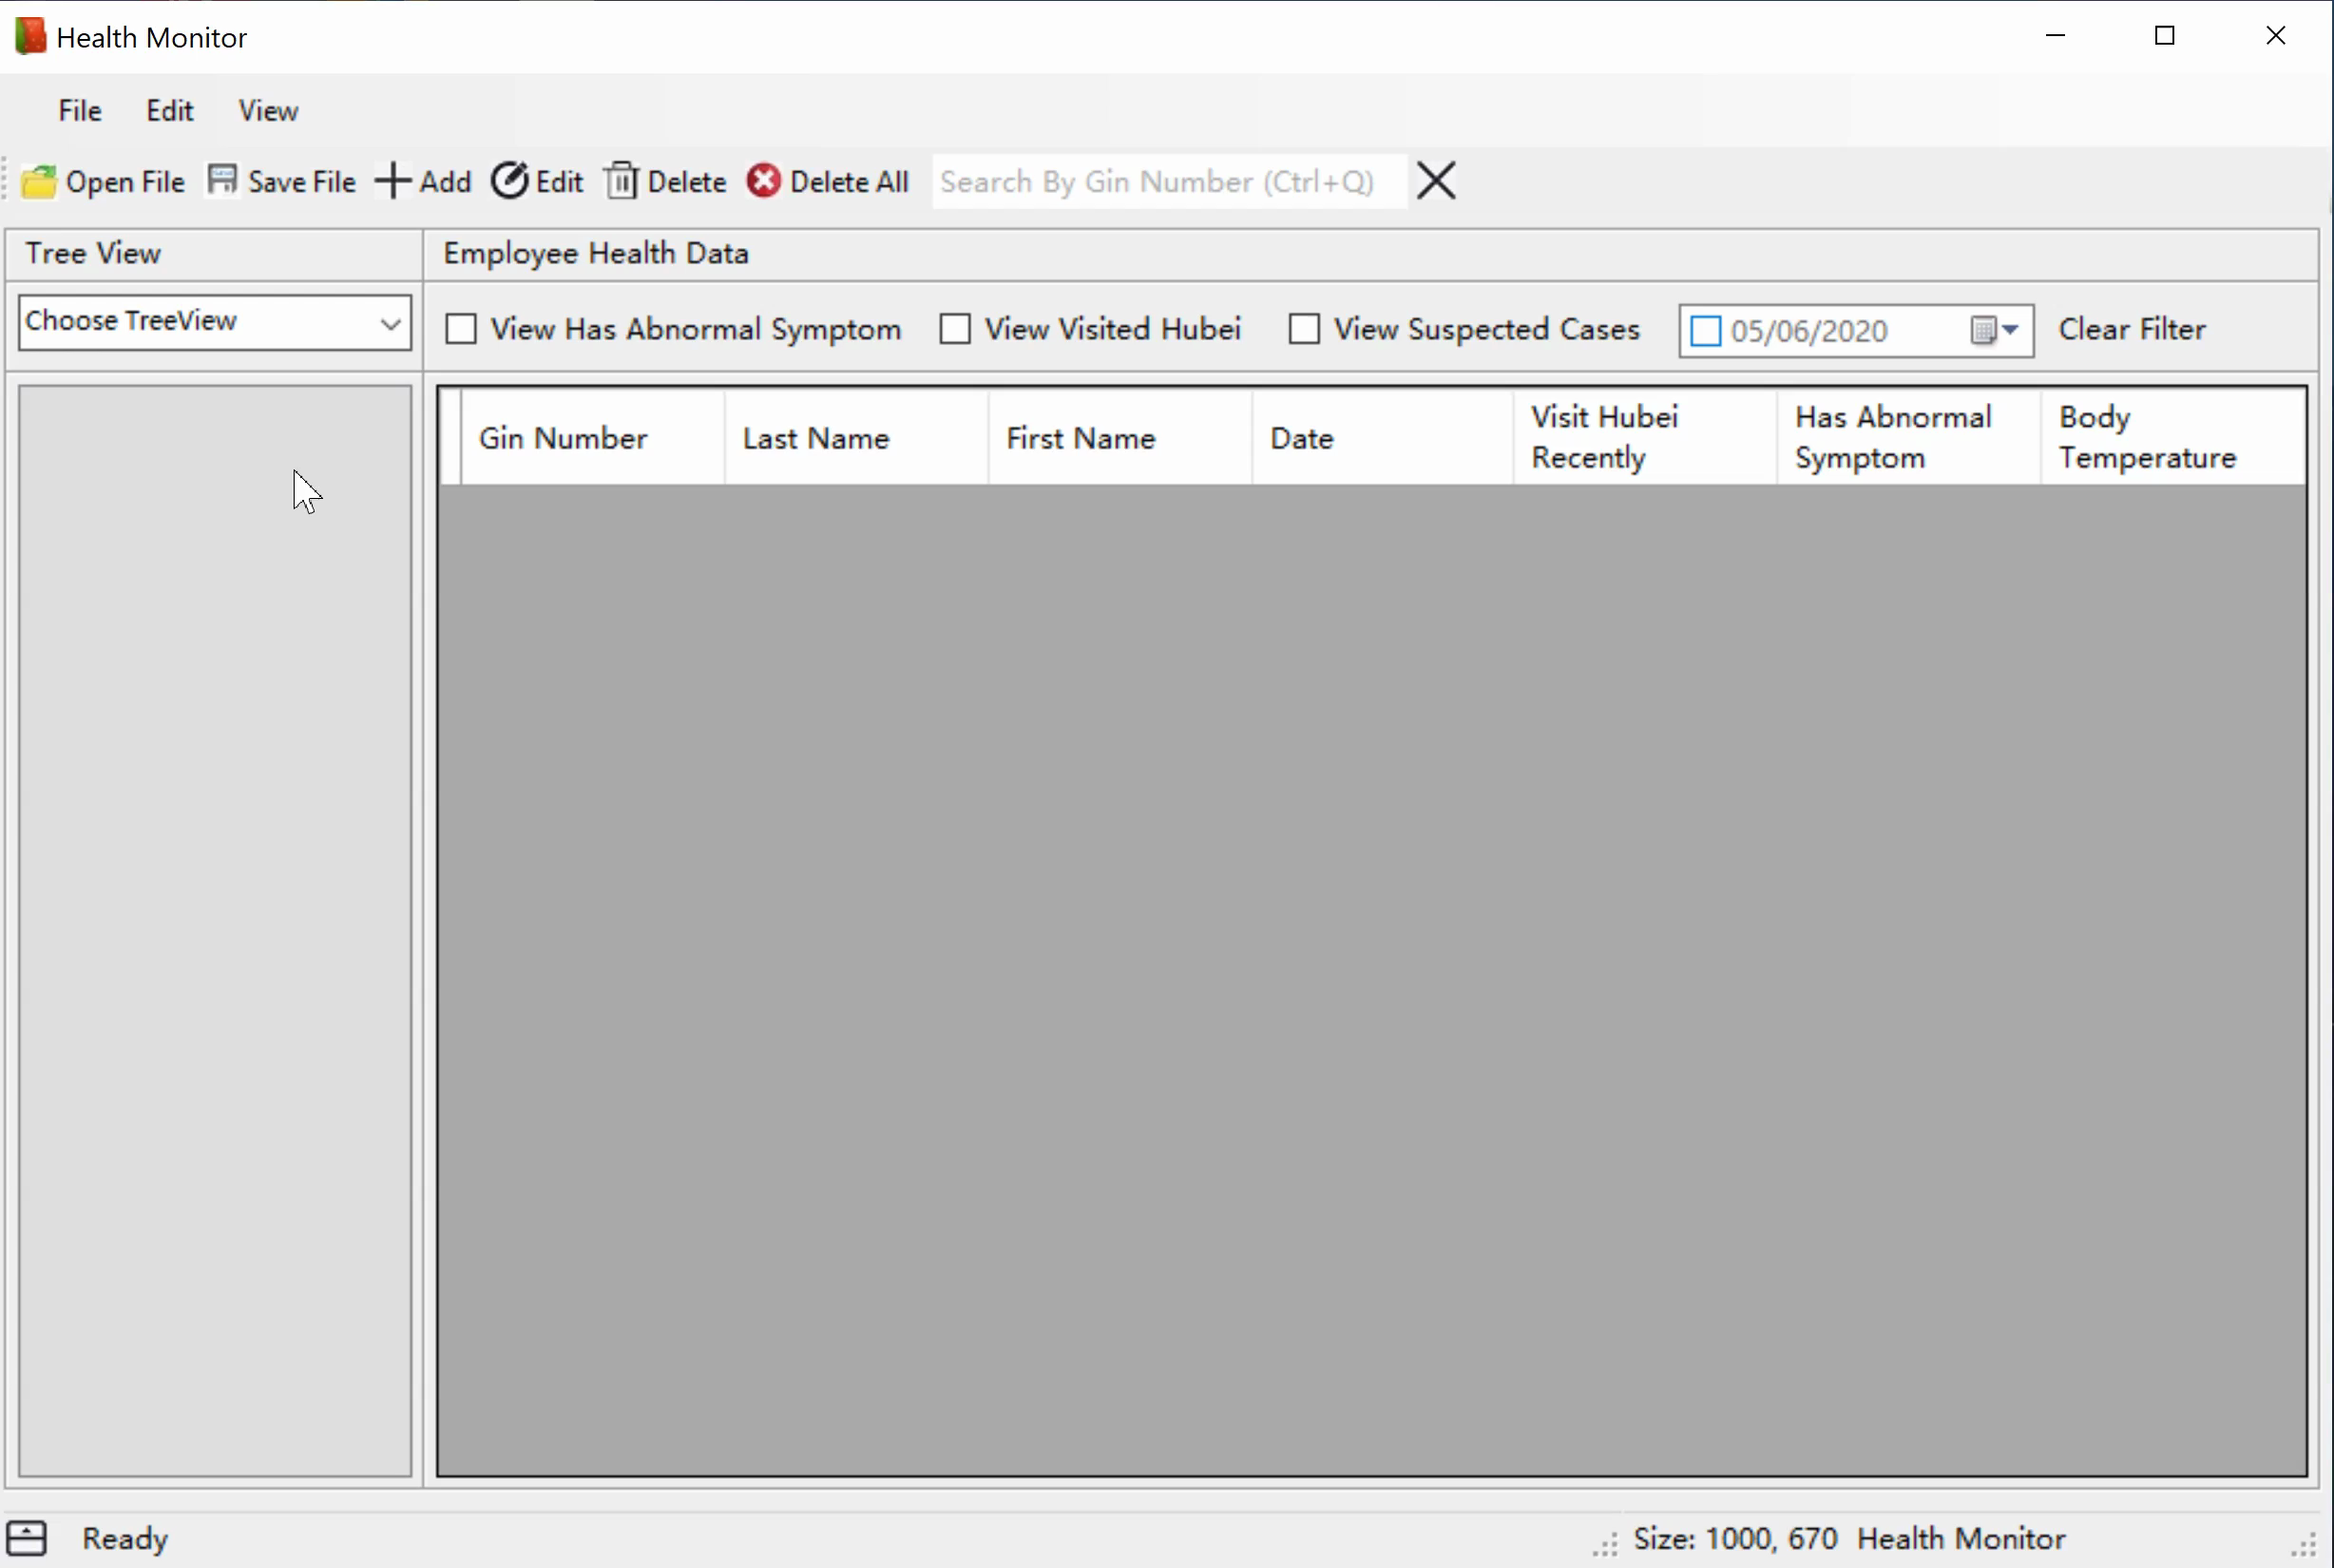
Using Daily Health Monitor: Open CSV File
Click Open File button under File at main menu / Click Open File button at toolbar
Choose a CSV file
Click OK
Note:
A warning would appear if user is adding or editing health record when clicks Open File button.

Slide 7
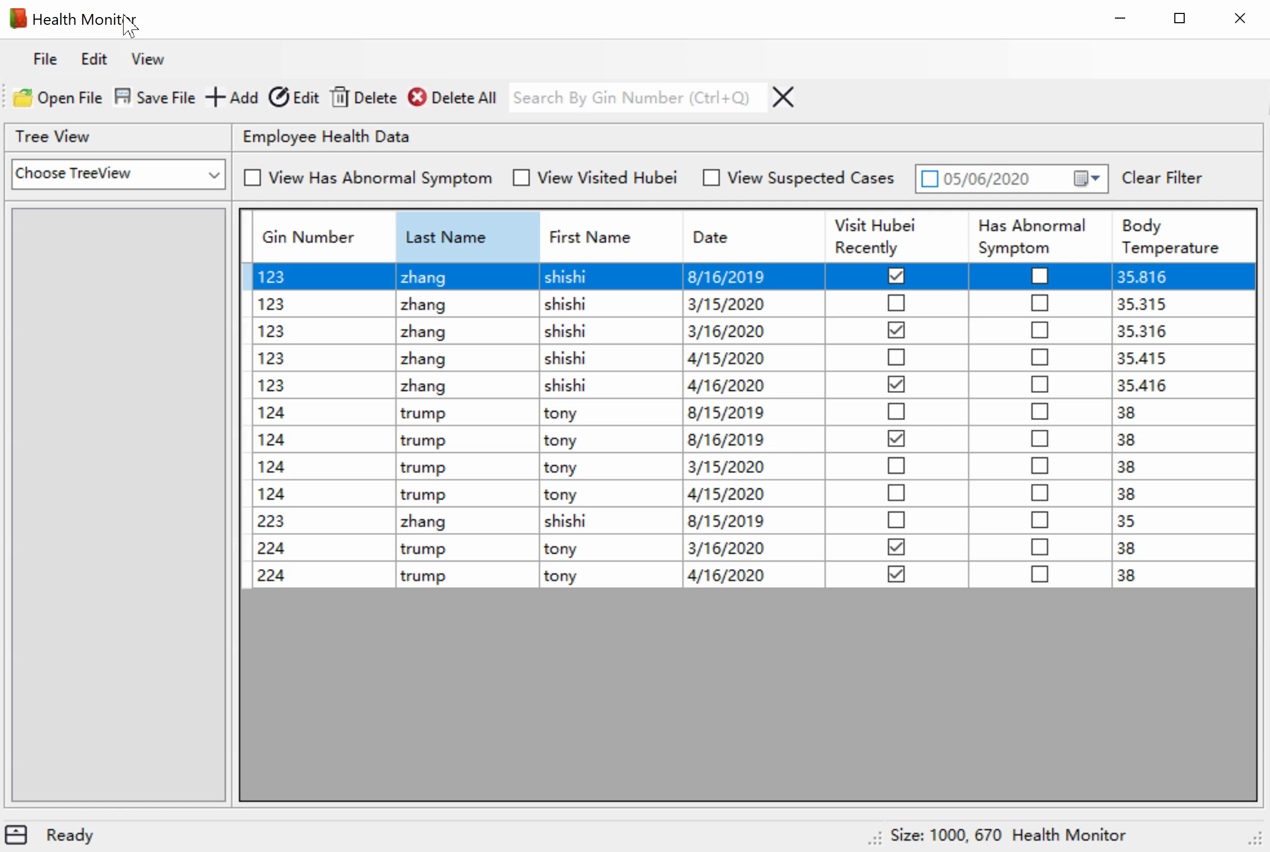
Using Daily Health Monitor: Add New Health Record
Click Add button under Edit at main menu / Click Add button at toolbar / Right click in the data grid view to pop up context menu then click Add button at context menu
Enter health record at the Add Form popped up
Click Add button at the Add Form
Note:
A warning would appear if user is editing health record when clicks Add button.
A message box would pop up if the input health record already exists.
A message box would pop up if the input Gin Number and name do not match the employee health records.
Error messages would appear if the input is in wrong format.

Slide 8
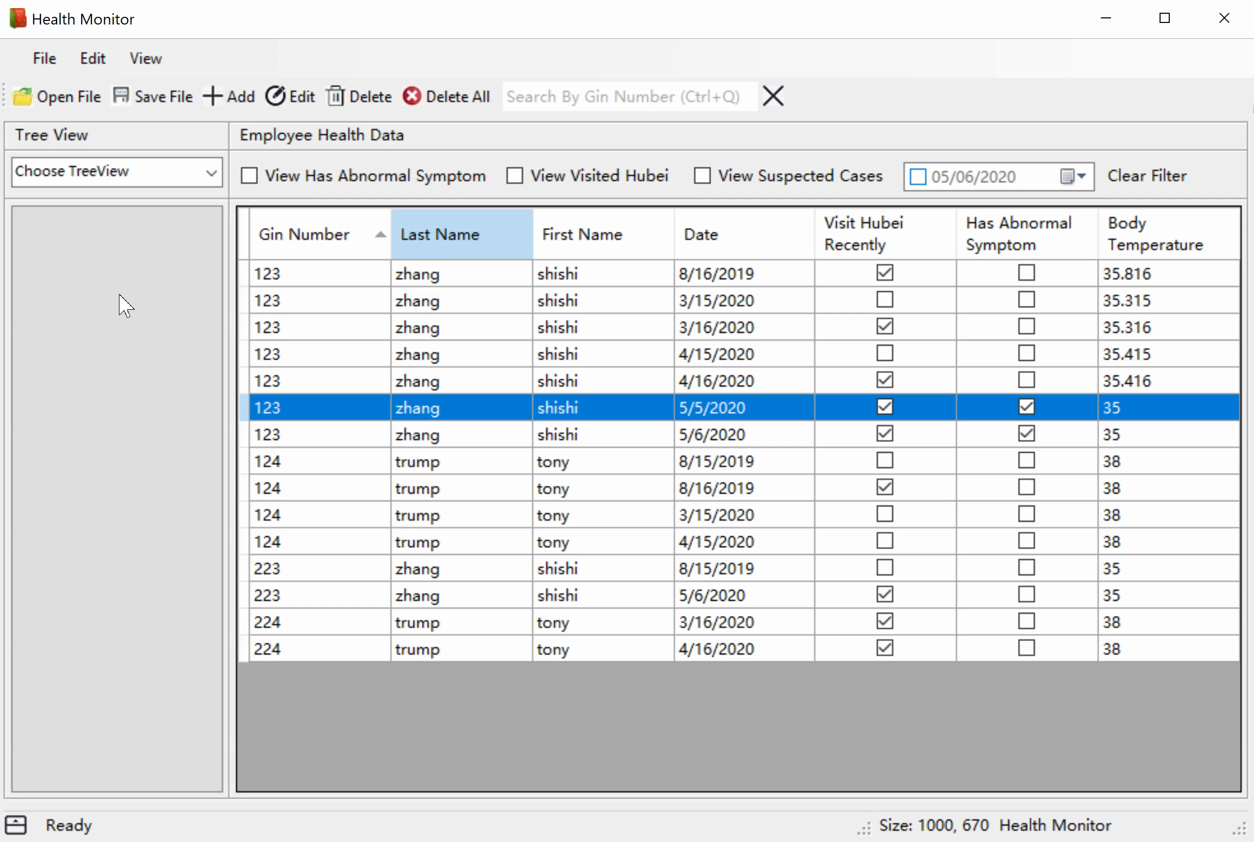
Using Daily Health Monitor: Edit Existed Health Record
Select a health record in data grid view
Click Edit button under Edit at main menu / Click Edit button at toolbar / Right click in the data grid view to pop up context menu then click Edit button at context menu
Edit health record at the Edit Form popped up
Click Save button at the Edit Form
Note:
A warning would appear if the user is adding health record when clicks Edit button.
A message box would pop up if the input health record already exists.
A message box would pop up if the input Gin Number and name do not match the employee health records. User can choose to update Gin Number and name if needed.
Error messages would appear if the input is in wrong format.

Slide 9
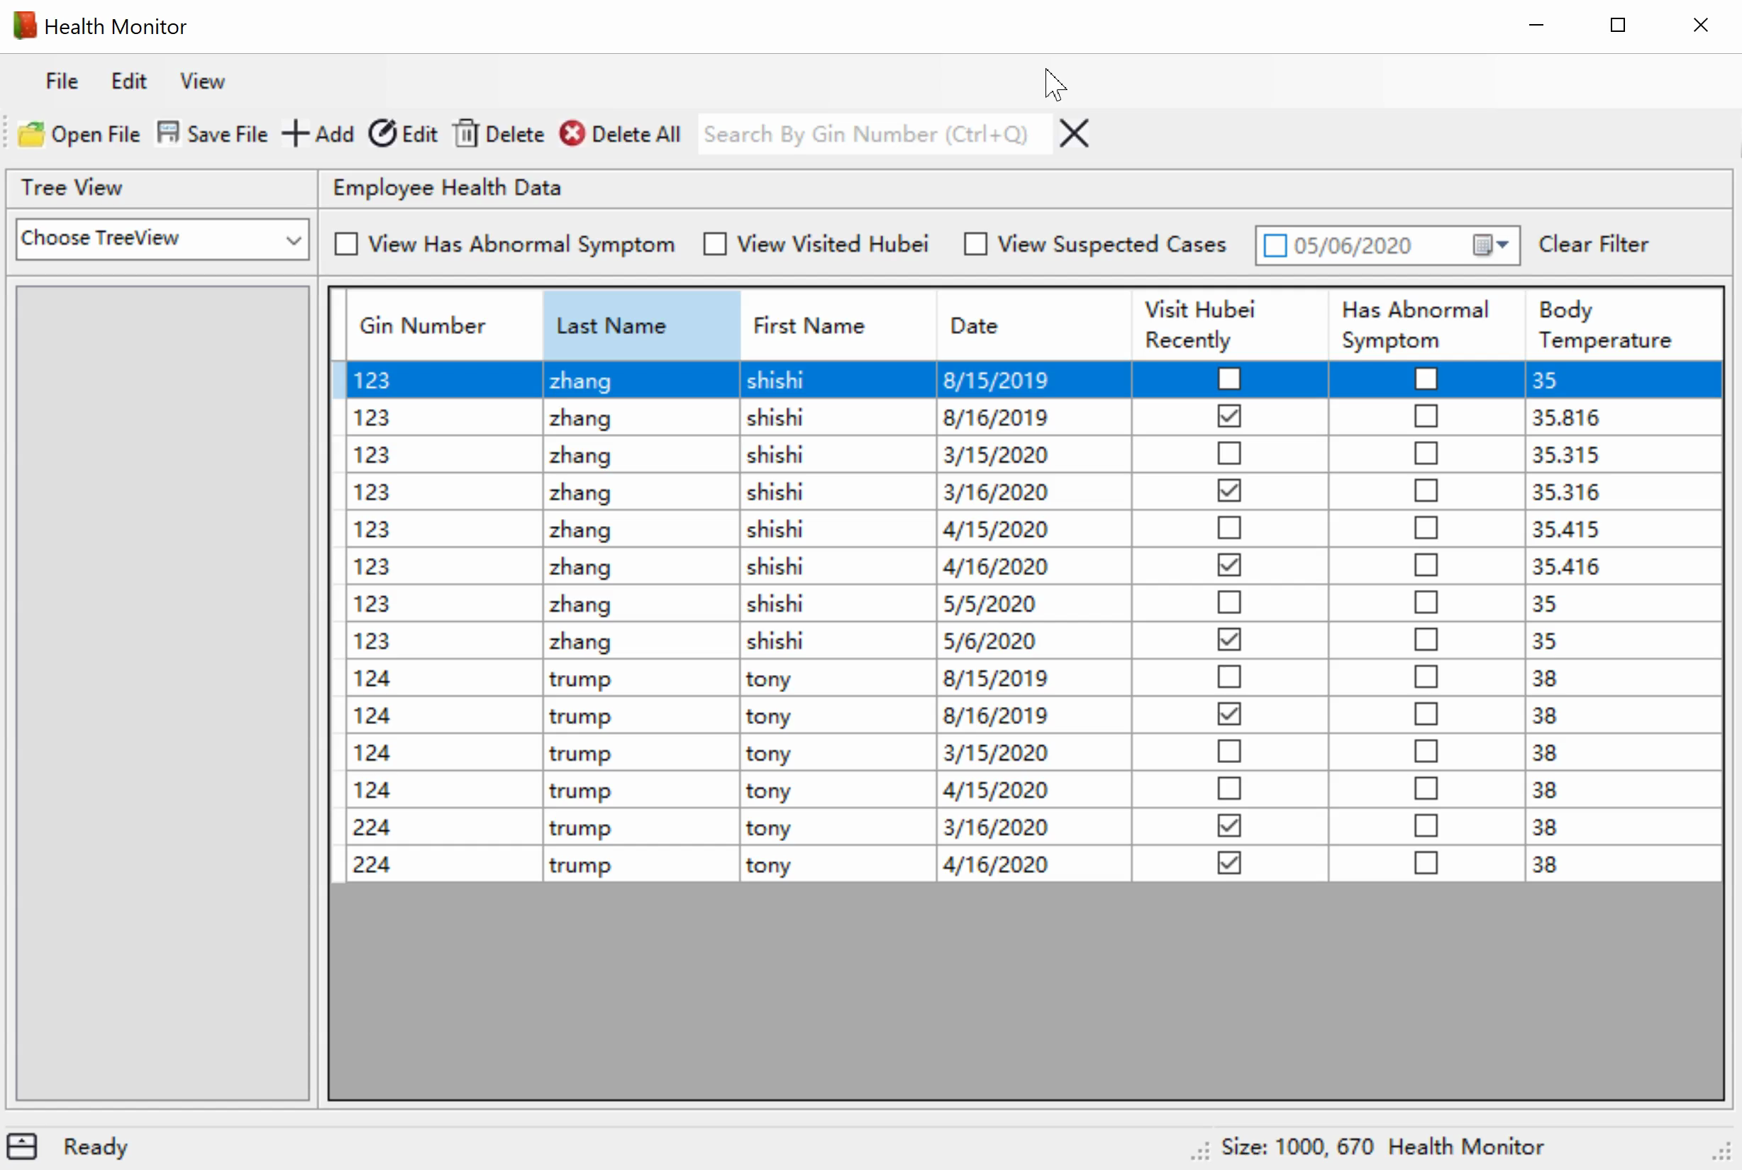
Using Daily Health Monitor: Delete Existed Health Record
Select a health record in the data grid view
Click Delete button under Edit at main menu / Click Delete button at toolbar / Right click in the data grid view to pop up context menu then click Delete button at context menu
Click OK
Note:
A warning would appear if the user is adding or editing health record when clicks Delete button.

Slide 10
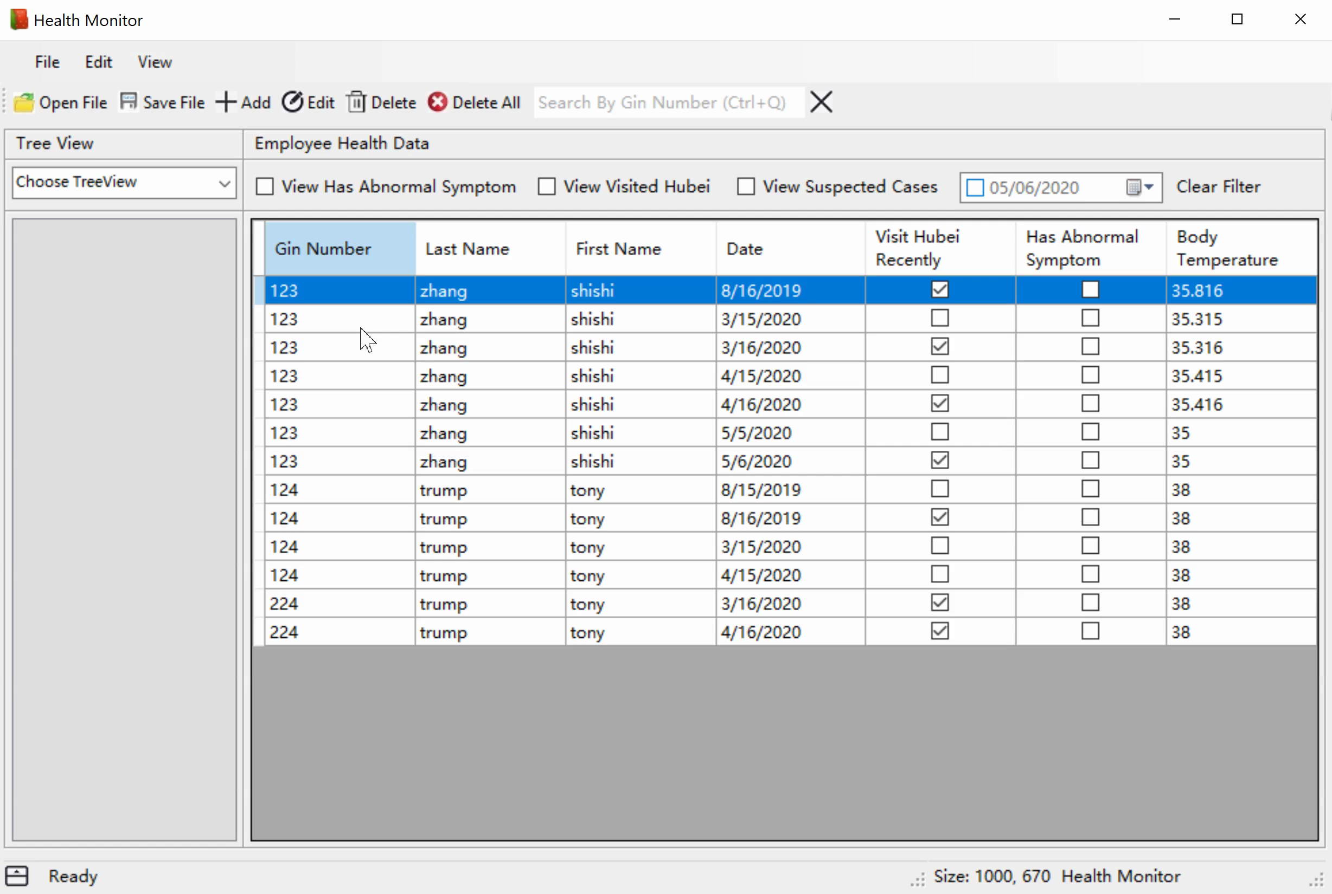
Using Daily Health Monitor: Delete All Health Records Displayed in Data Grid View
Click Delete All button at toolbar
Click OK
Note:
A warning would appear if the user is adding or editing health record when clicks Delete All button.
Clicking Delete All button only delete health records displayed in data grid view, not all health records.

Slide 11
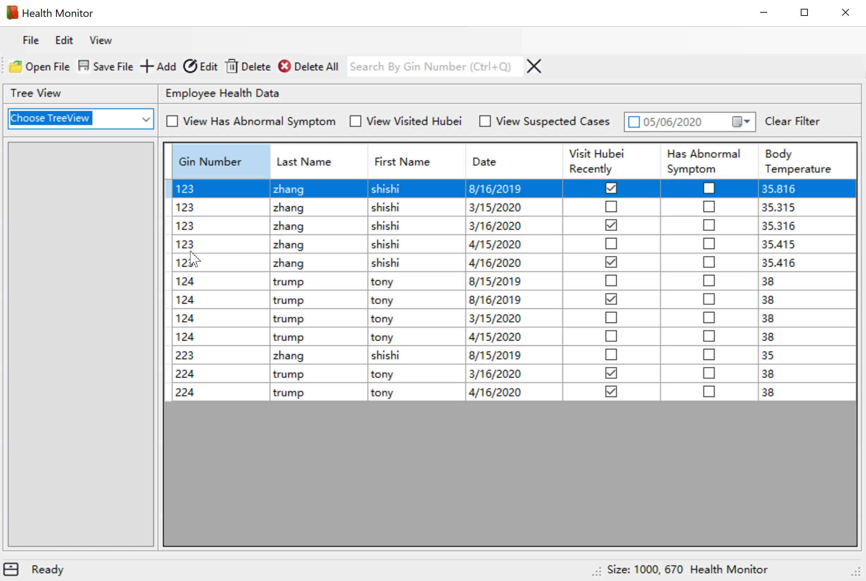
Using Daily Health Monitor: View Health Records by Year, Month, or Date
Click Choose TreeView dropdown-menu and select Date TreeView
Click a node in Date TreeView to view health records by year, month, or date
Note:
The TreeView can be applied with other filters.

Slide 12

Using Daily Health Monitor: View Health Records by Last Name or Gin Number and Name
Click Choose TreeView dropdown-menu and select Name & Gin Number TreeView
Click a node in Name & Gin Number TreeView to view health records by last name or Gin Number and name
Note:
The TreeView can be applied with other filters.

Slide 13
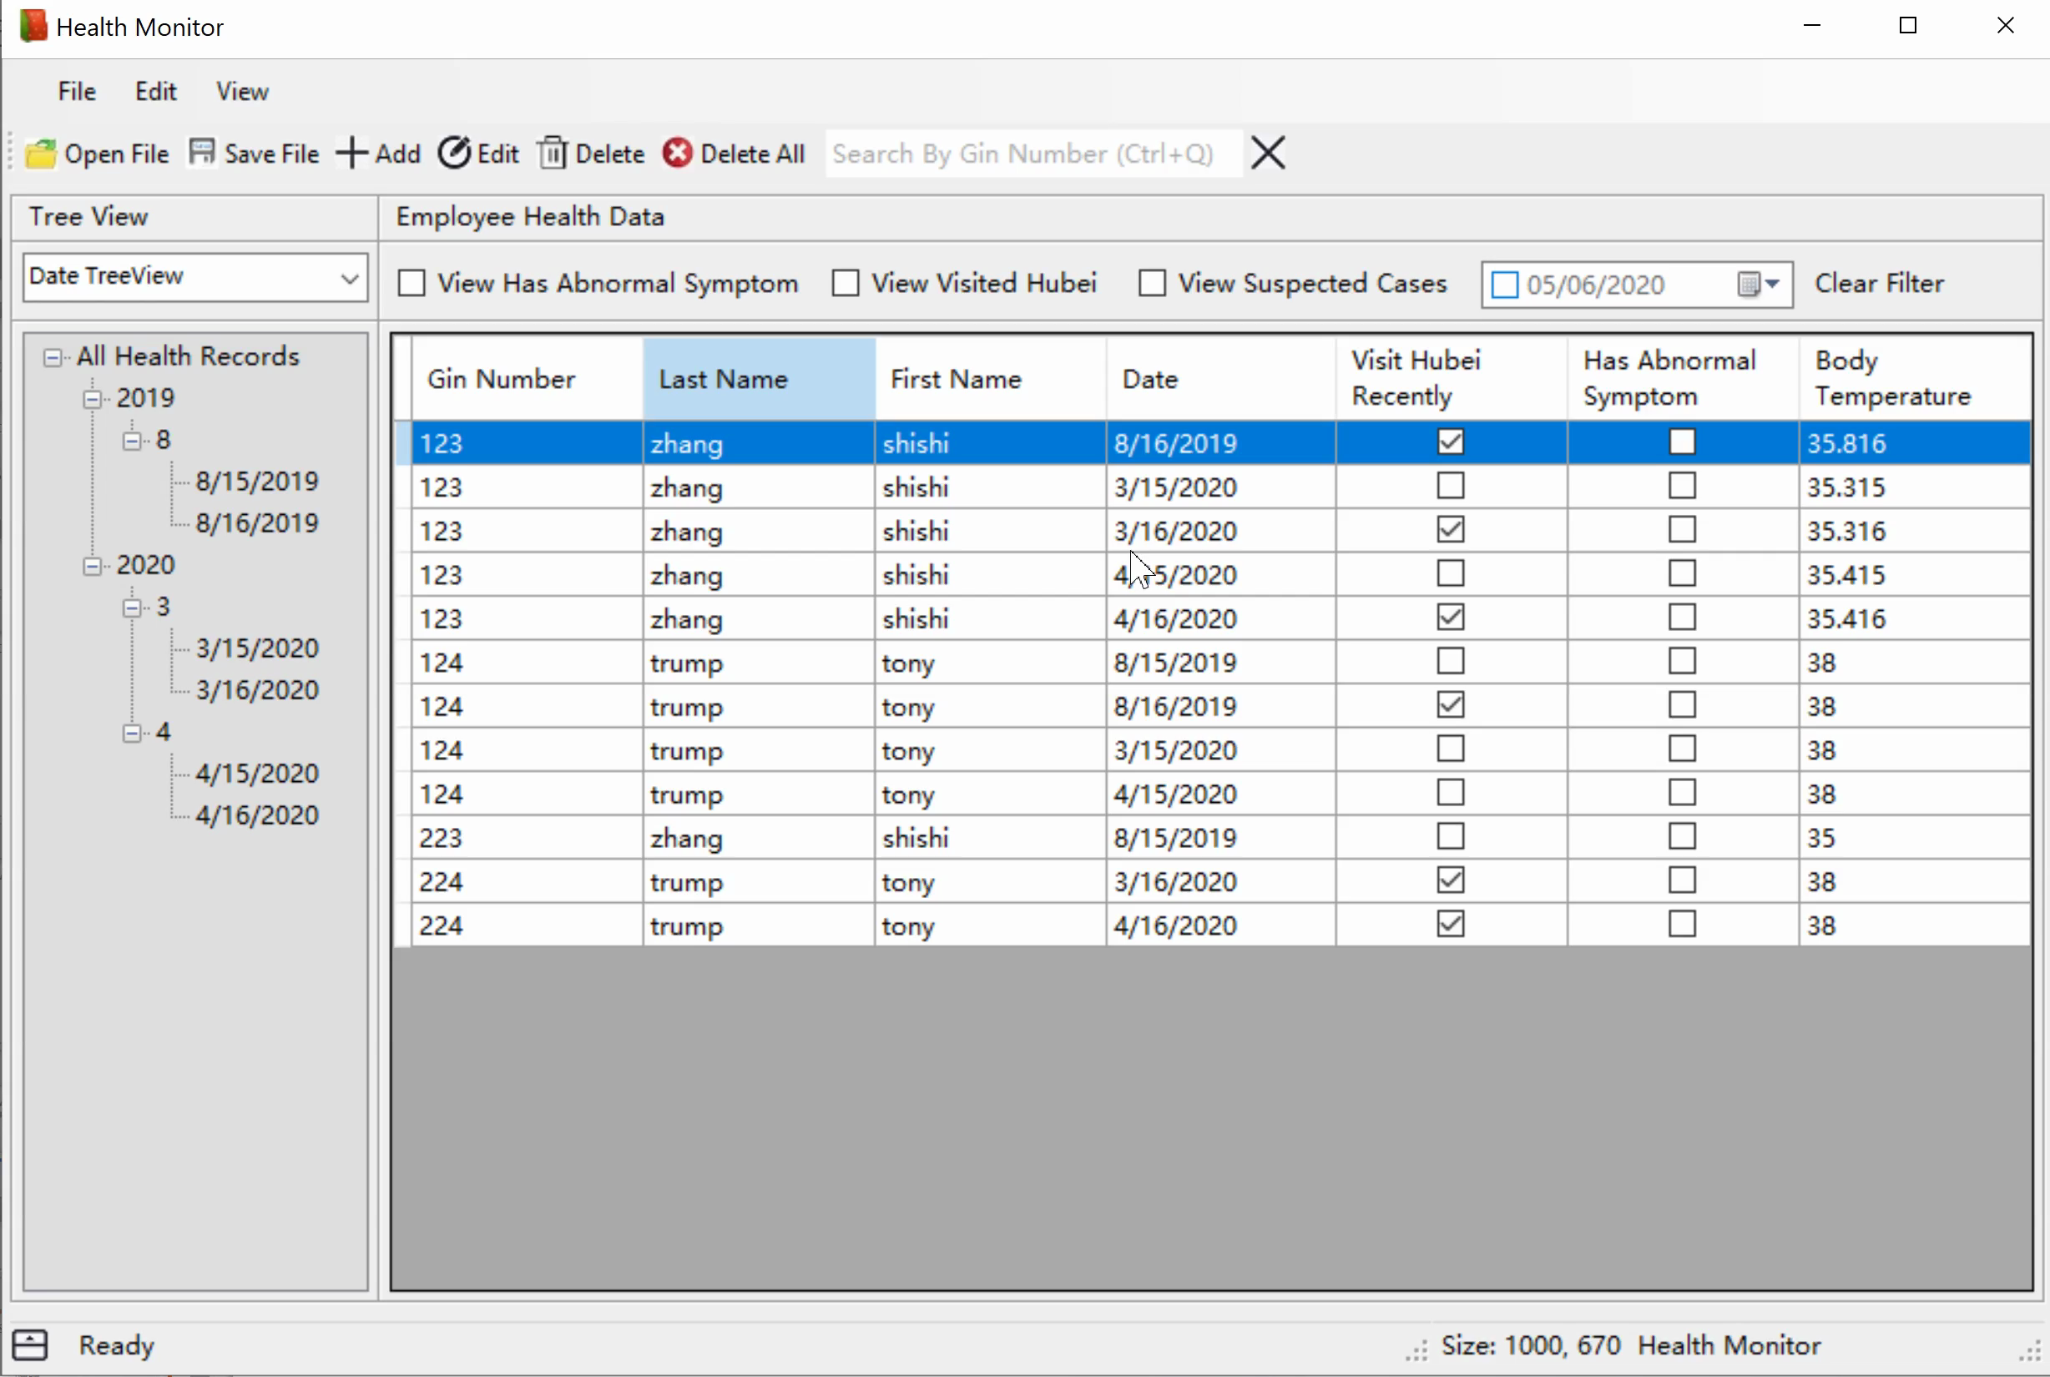
Using Daily Health Monitor: Search Health Records by Gin Number
Enter a Gin Number in Search By Gin Number textbox at toolbar
Press Enter
Click Clear Gin Number Filter button at toolbar to remove the Gin Number filter
Note:
The Gin Number filter can be applied with other filters.
A message box would pop up if the input is empty.
A message box would pop up if the input is in a wrong format (not a positive integer).

Slide 14
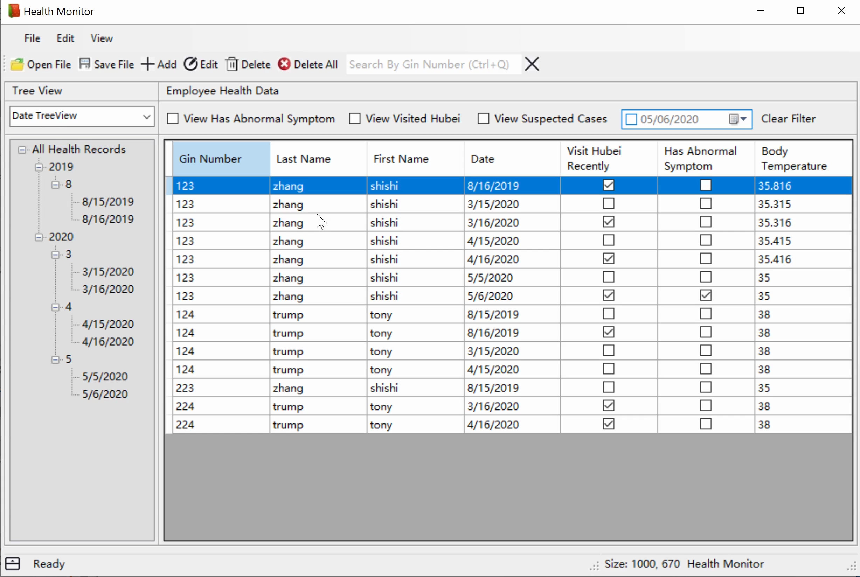
Using Daily Health Monitor: Search Health Records by Date, Visited Hubei or Not, Has Abnormal Symptom or Not, or Suspected Case
Check the checkbox to apply filter
Uncheck the checkbox to remove filter
Click Clear Filter Label to remove all the filters
Note:
Filter can be applied with other filters.

Slide 15

Using Daily Health Monitor: Sort Health Records by Gin Number, First Name, Last Name or Date
Click column header of the data grid view to sort the health records

Slide 16

Using Daily Health Monitor: View Status Bar
Check View Status Bar button under View at main menu to view current status
Uncheck View Status Bar button under View at main menu to hide status bar / Click Hide Status Bar button at status bar to hide the status bar

Slide 17
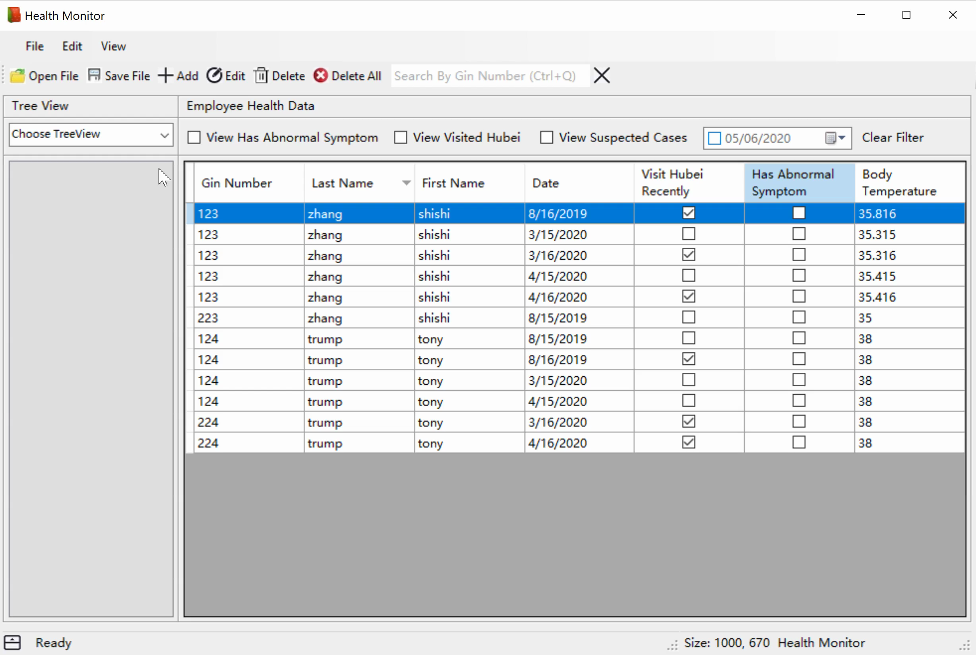
Using Daily Health Monitor: View Toolbar
Check View Toolbar button under View at main menu to view the toolbar
Uncheck View Toolbar button under View at main menu to hide the toolbar

Slide 18

Using Daily Health Monitor: Save As CSV File
Click Save File button under File at main menu / Click Save File button at toolbar.
Choose a path to save the file
Click OK
Note:
A warning would appear if user is adding or editing health record when clicks Save File button.

Slide 19
Get Support
Contact Information:
Email: sz559@cornell.edu
Phone: 13648055816

